Slide 1

Project: Population Regression
Group 3
Reporter: Yang Jingyuan, Zhao Yuan
Group Member: Yang Jingyuan(Header), Zhao Yuan, Zhang Haonan, Chen Yuxuan, Jiang Fengcheng,Du Jiacheng, Chen Yunquan, Shi Jianchuang

Slide 2
Structure
Introduction
Codes and Project
A
B
A
Teamwork and a brief introduction to the project
B
Demonstrate the actual effect of the project and part of the codes
Conclusion
C
D
Future Work
C
Presentation of project conclusions and accuracy assessments
D
How to improve the accuracy of the model

Slide 3
1
Introduction

Slide 4
Teamwork
Team
Work
Organization; Code; PPT; Report Yang Jingyuan
Zhao Yuan Code; Visualization; PPT
Code; PPT Zhang Haonan
Jiang Fengcheng Code; PPT
Code; Report Chen Yuxuan
Du Jiacheng Code; PPT
Code; PPT Chen Yunquan
Shi Jianchuang PPT

Slide 5
Project Description
1
2
Calculate the population model of Singapore and China based on the data
Use machine learning model to make population predictions
Population Regression
3
4
Calculate some parameters of the best fit line and the model
Improve the accuracy in the future

Slide 6
Article structure
1
2
Why Study Population Growth?
Population Growth Basics and the American Bison
Better predictions about future changes in population sizes
exponential population growth can lead to dramatic environmental degradation
4
3
What about Human Population Growth?
After the Boom: Limits to Growing Out of Control
human population growth is affected by cultural, economic, and social factors that determine not only how the population grows, but also the potential carrying capacity of the Earth.
characteristics of the species as lifespan and fecundity, and environmental conditions, determined how much and how fast.

Slide 7
2
Codes and Project

Slide 8
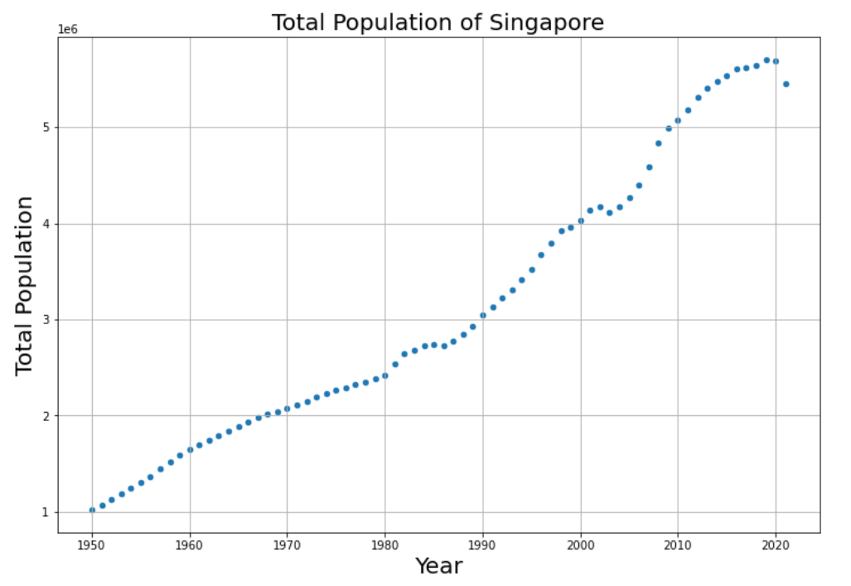
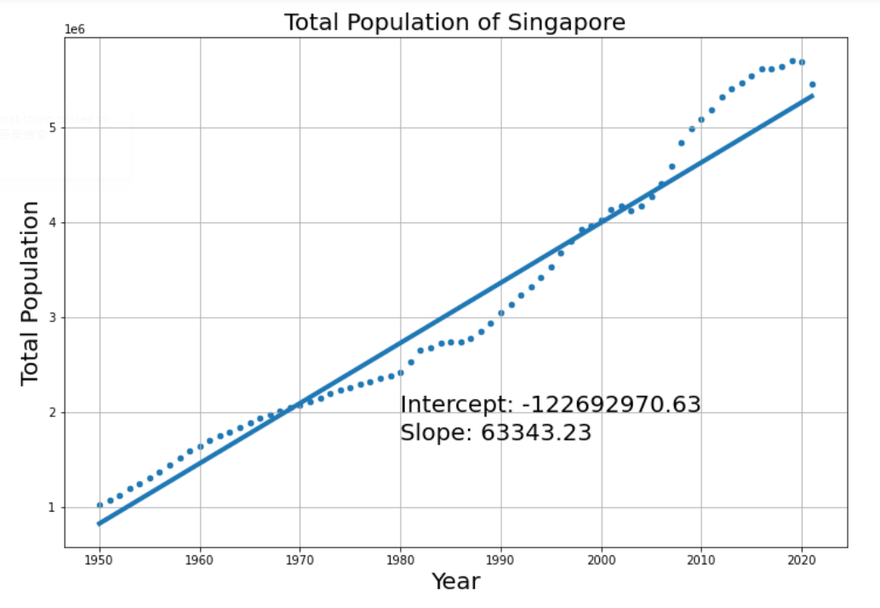
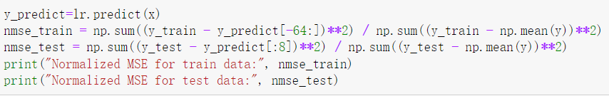
Total Population of Singapore from 1950 to 2021
Data before 2013 : training data Remaining data : test data
Mean Squared Error for train data: 55496493545.96
Mean Squared Error for test data: 257594689765.74
Normalized MSE for train data: 0.03652981849117039
Normalized MSE for test data: 0.04254007327940072
The R2 coefficient for the best fit line: 0.9614714944982808
Prediction for 2030 and 2050: 2030 —— 5893779 2050 —— 7160643

Slide 9
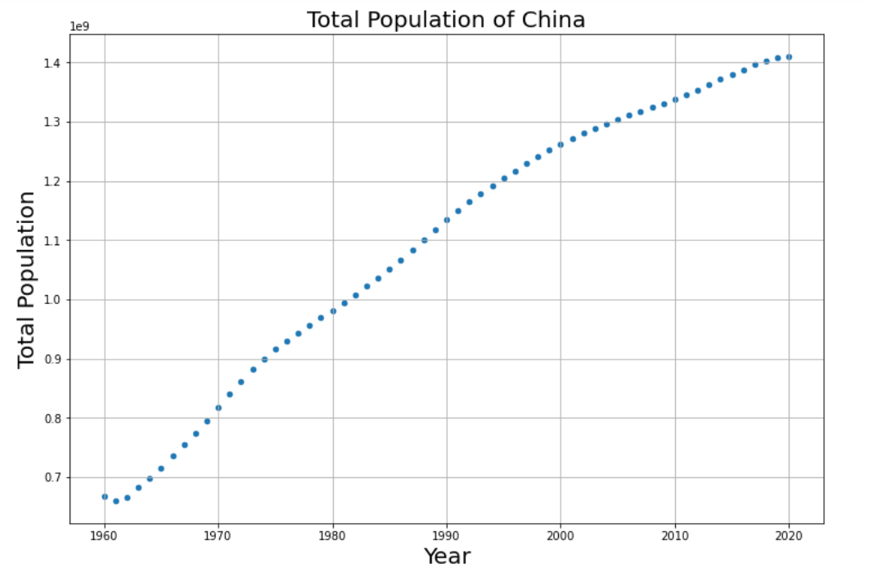
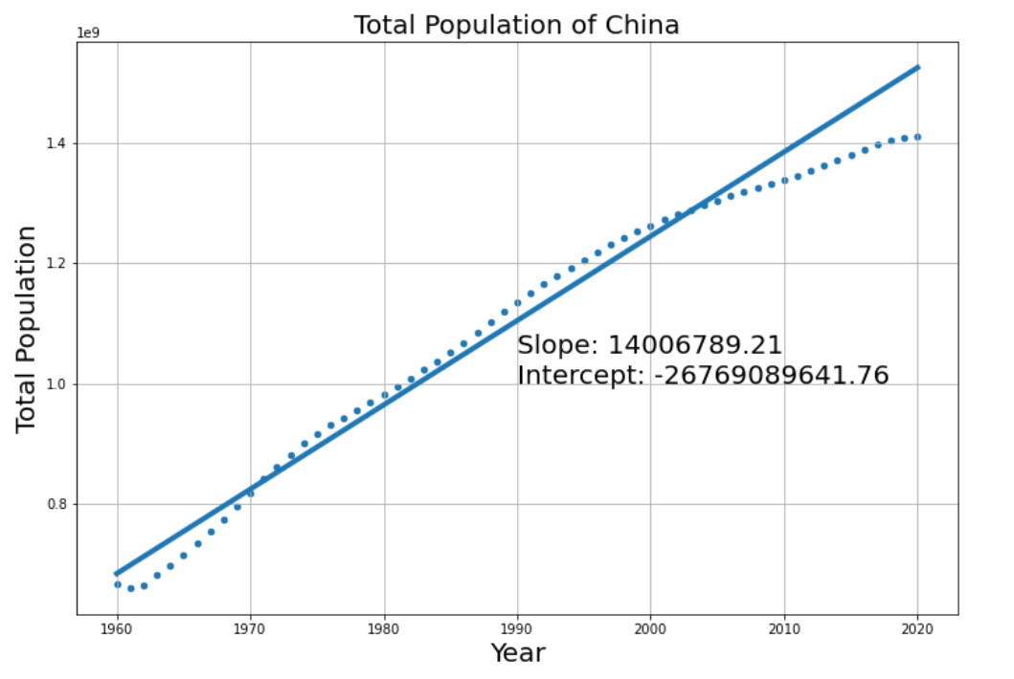
Total Population of China from 1960 to 2020
Mean Squared Error for train data: 811985540736408.50
Mean Squared Error for test data: 8088282817982782.00
Normalized MSE for train data: 0.01624667590770196
Normalized MSE for test data: 0.08990166993014194
The R2 coefficient for the best fit line: 0.9614714944982808
Prediction for 2030 and 2050: 2030 —— 1664692460 2050 —— 1944828245
Some Prarameters

Slide 10
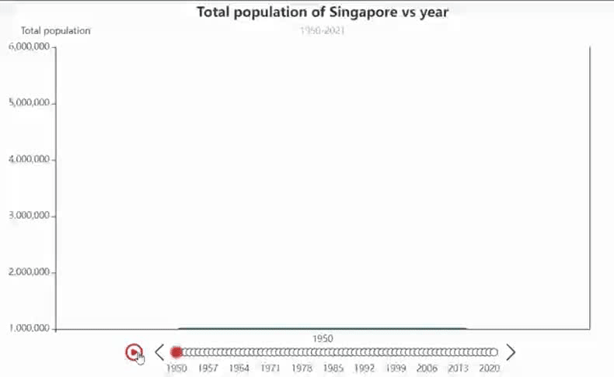
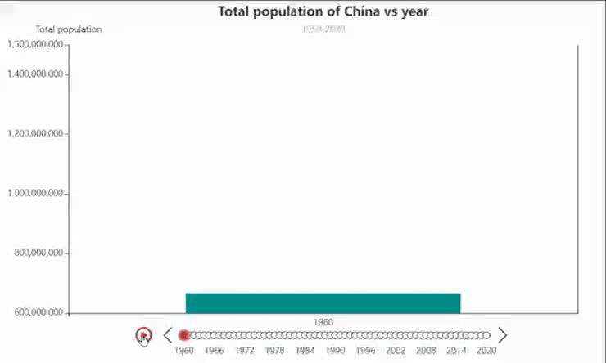
The changes in Singapore’s total population
pyecharts
dynamic histograms
The changes in China’s total population

Slide 11
3
Conclusion

Slide 12
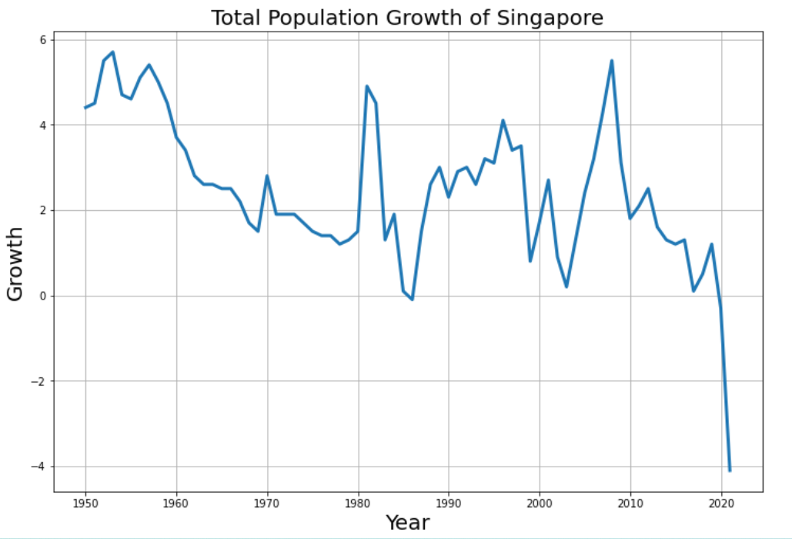
Singapore's Population
This model does not take into account objective factors.
The number of people of childbearing age
People's willingness to have children
The cost of raising children
Ideology
Some unexpected events(COVID-19)

Slide 13
China's Population
By reviewing the relevant data, we can see that for China now, the uncertainty of future population growth has increased with the emergence of factors such as population aging and the gradual decrease of the fertility rate.
According to the data, the maximum population carrying capacity of China should be controlled at about 1.6 billion, and the current population of China is already close to this carrying capacity, therefore, the future population growth rate is bound to become slower and slower, or even a trend of zero growth or negative growth.
(Reference: Study on the Productive Capacity of Land Resources and the Carrying Capacity of Population in China)

Slide 14
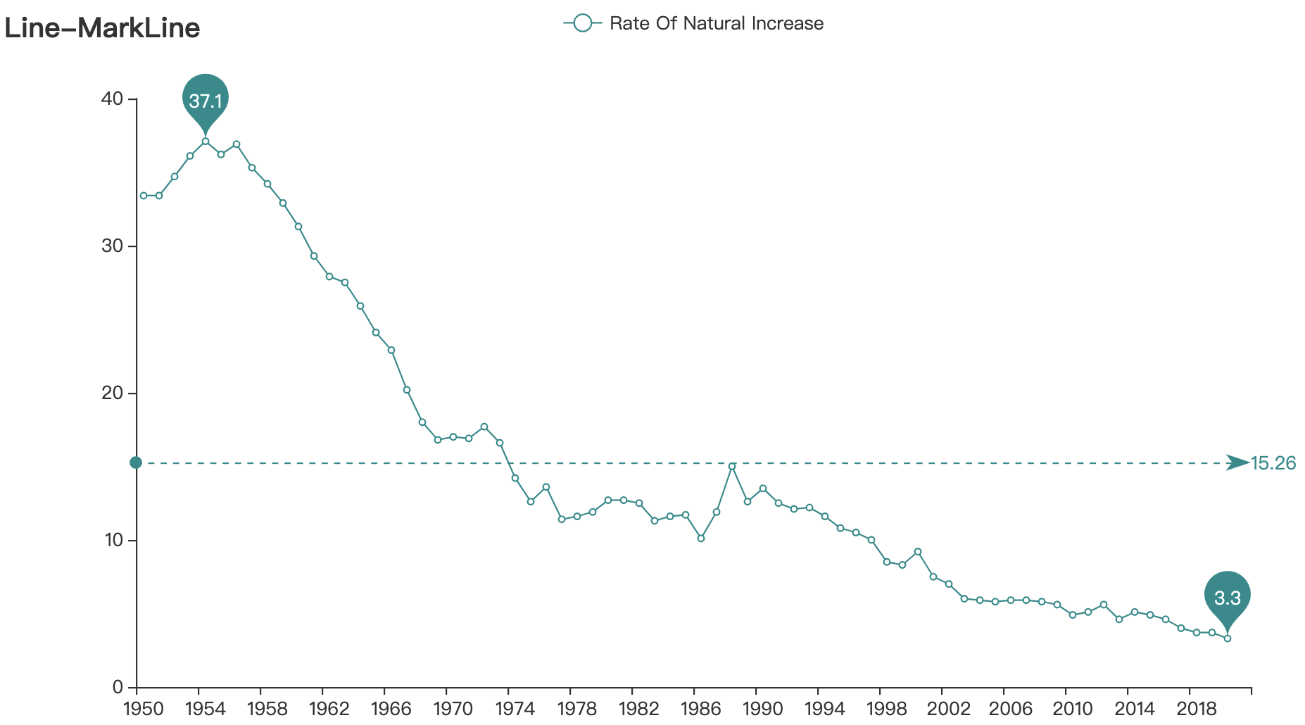
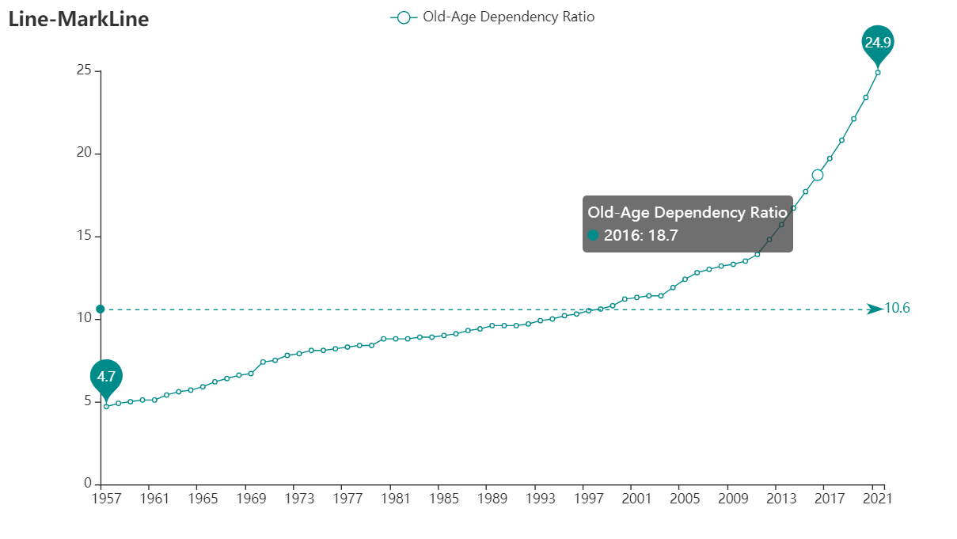
The pattern for population growth in Singapore & China: Modern Type
Basic features:
Birth rate of the population: began to decline significantly
Mortality rate: continued to decline and reached a low level
Natural growth rate: gradually decreases, and some developed countries even begin to experience negative or zero growth.
Pros: Effectively alleviate the trend of rapid population growth
Cons: Lack of social labor force: which is not conducive to industrial development and the economic development of the country; Population aging: increasing the burden of social welfare
Distribution: Most developed countries.

Slide 15
4
Future Work

Slide 16
How to improve the accuracy
Changes in population are influenced by many factors that are difficult to predict and quantify.
Linear regression model cannot be perfect。

Slide 17
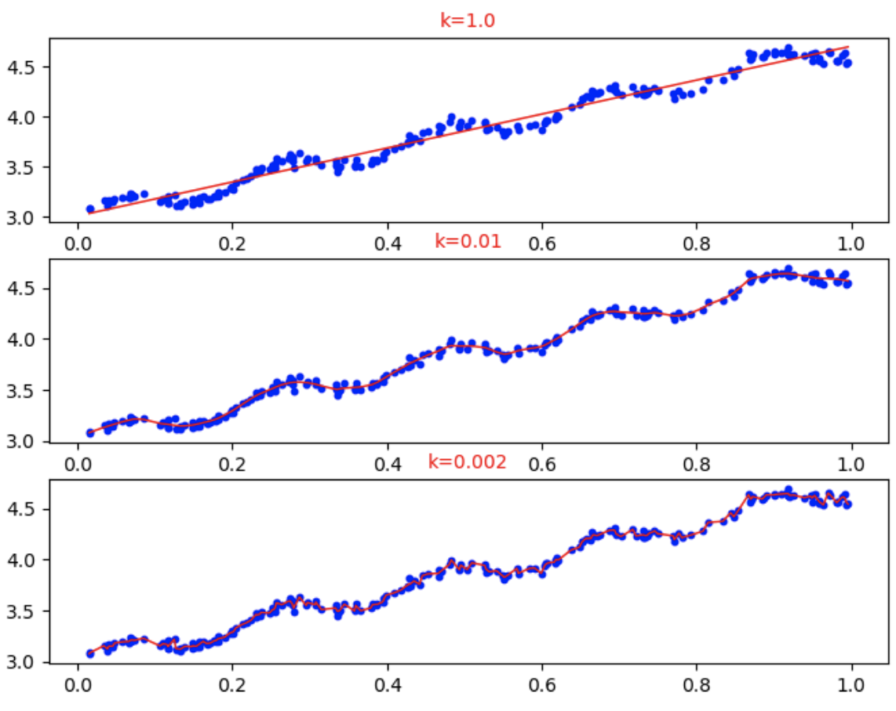
How to improve the accuracy
improve
Although ordinary linear regression can fit the regression curve, it is too coarse and will appear underfitting phenomenon.
Locally weighted linear regression (LWLR) reduces the mean square error of the prediction by introducing some bias in the estimates.
The basic idea of this method is to assign a certain weight to each point near the point to be predicted, and store these weights in a new matrix W.
Better prediction results can be obtained by local weighted regression, but adjusting the parameter k is the key, and k is too small may appear overfitting phenomenon.

Slide 18
THANKS!

